Slide 1
Introduction to Motion Control
Rochester MakerSpace
2021

Slide 2
Class Objectives
Become familiar common types of motors
Focus on motors typically used by hobbyists
Understand how to control motors
Understand cautions when using motors with microcontrollers/microcomputers
Provide projects to demonstrate motor control on Raspberry Pi and Arduino
Provide examples of typical motor applications
Provide list of resources for learning more

Slide 3
Class notes and code
All the class notes and code can be downloaded from GitHub:
https://github.com/RochesterMakerSpace/MotionControlClass
Pull down the green “Code” button and select “Download ZIP”

Slide 4
Motor Glossary
Torque: is a rotating force produced by a motor’s crankshaft. The more torque the motor produces, the greater is its ability to perform work. Since torque is a vector acting in a direction it is commonly quantified by the units Nm or foot-pounds.
Power: is how rapidly work is accomplished - work in a given amount of time. Power is quantified in watts (J/s) or horse power.
Open loop: has no feedback or mechanisms for error regulation to determine if its output has achieved the desired goal of the input
Repeatability: a drive mechanism’s ability to return to the same position multiple times under identical conditions
Accuracy: the degree in measurement for motion can be determined to which the final position matches the commanded position
Motor overload: occurs when a motor is under excessive load causing excessive current draw, insufficient torque and overheating
Motor efficiency: the comparison of the amount of mechanical work the motor performs and the electrical power it consumes to do the work
Resonance: as the motor comes to rest it tends to overshoot the final resting point and oscillates round this point as it comes to rest

Slide 5
Types of Common Electric Motors
There are two main motor classifications, ac and dc, with three application areas, constant speed, variable speed and position (or torque) control.
AC Motors
AC motors are typically associated with industrial applications and will not be address further in this class.
DC Motors
Although large DC motor are common in industrial application smaller DC motor are favored by the hobbyist and include:
DC Brushed Motors – simple, cost effective, lightweight and easy to control. Excellent torque at low speed but produce electrical noise. Used as drives for hobby vehicles.
DC Brushless Motors -- mechanically simpler than brushed motors but require more complex controllers and gearboxes and can be found in multi-coptors and drones.
Servo Motors – good for projects needing precise control of angular or linear position such as robots.
Stepper Motors – move in discrete, precise steps and are found in CNC machines and 3D printers.

Slide 6
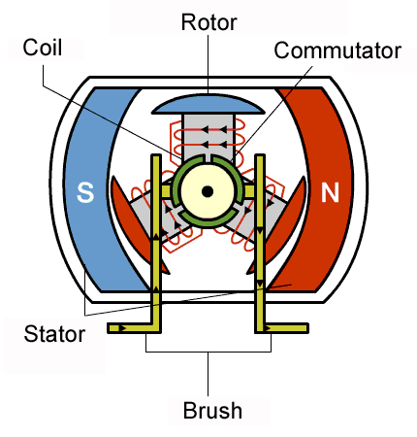
Brushed DC Motor Description
Components:
Stator: Generates a stationary magnetic field that surrounds the rotor
Rotor (armature): Made up of one or more windings. Produce a magnetic field when energized
Brushes: As the motor turns, carbon brushes slide over the commutator, coming in contact with different segments of the commutator
Commutator: Segments are attached to different rotor windings, generating a dynamic magnetic field inside the motor.

Slide 7
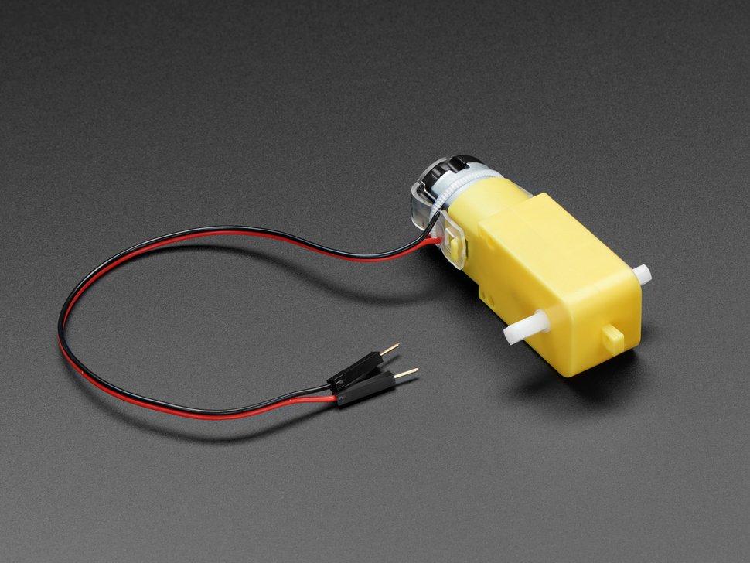
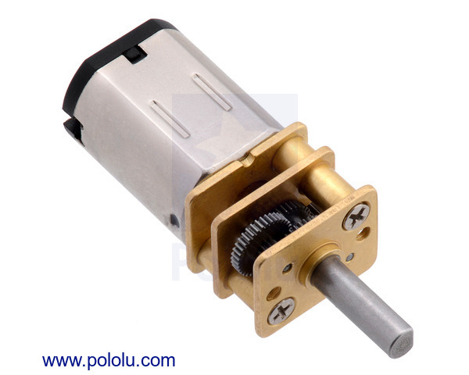
Brushed DC Motor Example
DC Gearbox Motor – “TT Motor” – 200 RPM – 3 to 6 VDC
Operating Voltage Range: 3~7.5V
Rated Voltage: 6V
Max No-load Current (3V): 140 mA
Max No-load Current (6V): 170 mA
No-load Speed (3V): 90 rpm
No-load Speed (6V): 160 rpm
Max Output Torque: 0.8 kgf cm
Max Stall Current: 2.8 A
Pololu Micro Metal Gearmotor
See spec sheet

Slide 8
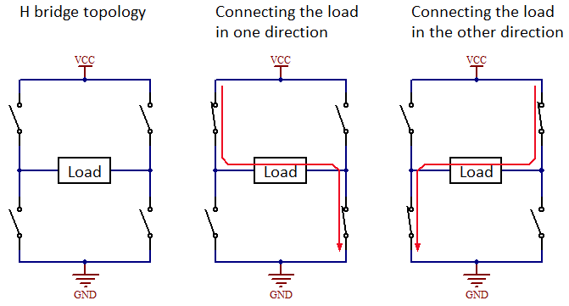
Brushed DC Direction Control: H-Bridge
An H-Bridge circuit contains four switches with the motor at the center forming an H-like arrangement.
Closing two particular switches at the same time reverses the polarity of the voltage applied to the motor. This causes change in spinning direction of the motor.
The control circuit prevents closing both switches on the same side of the H-Bridge, thus preventing a short from Vcc to GND.

Slide 9
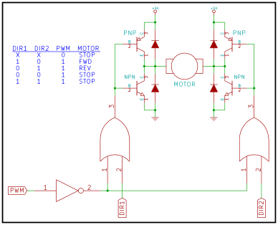
H-Bridge with PWM Control

Slide 10
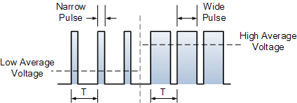
Brushed DC Speed Control: PWM

Slide 11
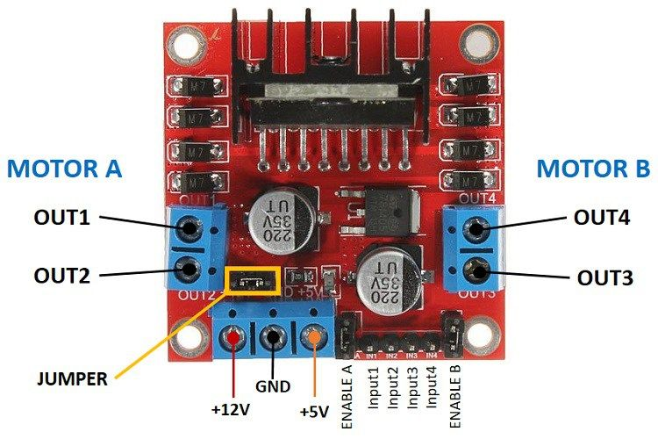
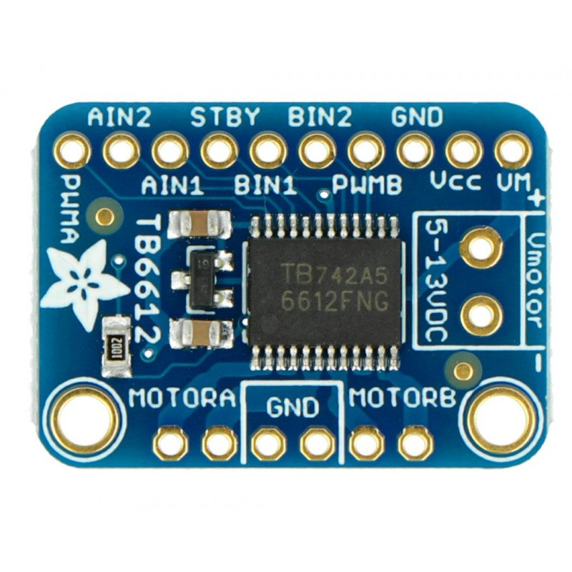
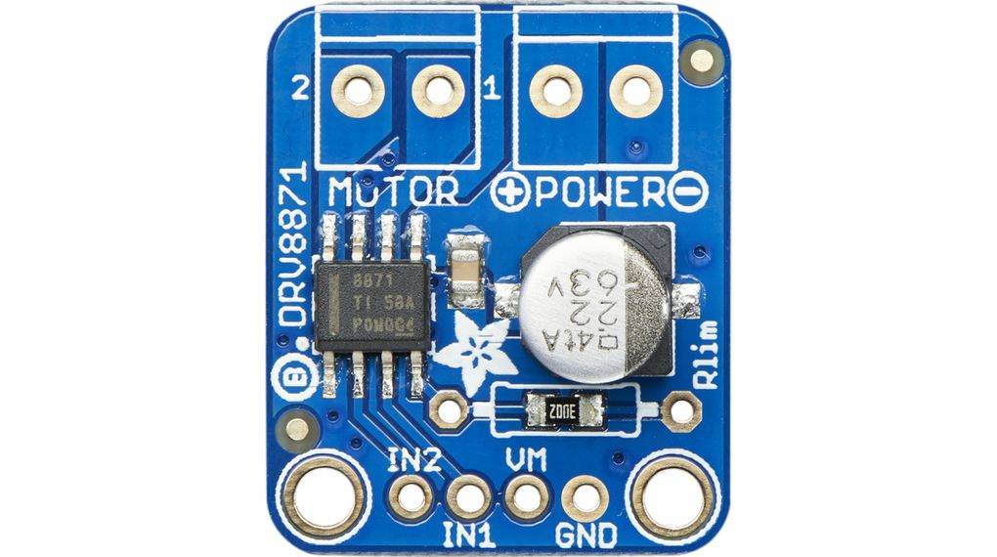
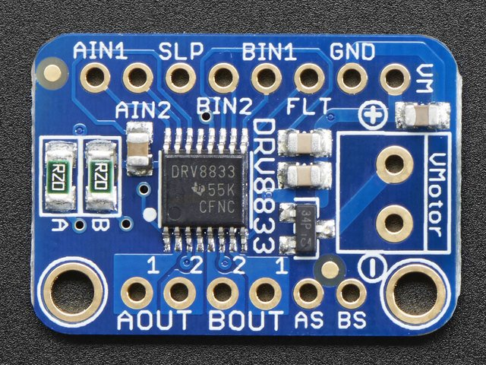
Brushed DC Motor Drivers
Model | L298N | TB6612 | DRV8833 | DRV8871
Current | 2A | 1.2A | 1.5A | 2A
Peak Current | 3A | 3.3A | 2A | 3.6A
Operating Voltage | 3.2 – 40 V | 4.5 – 15 V | 2.7 – 10.8 V | 6.5 – 45 V
Efficiency | 40-70% | 91-95% | 70-90%
Total MCU pins | 6 | 6 | 4 | 2
PWM Pins | 2 | 2 | 2/4 | 2
Number of motor outputs | 2 | 2 | 2 | 1
Technology | Bipolar | MOSFET | MOSFET | MOSFET
Approximate cost | $2.50 | $5.00 | $5.00 | $7.50

Slide 12
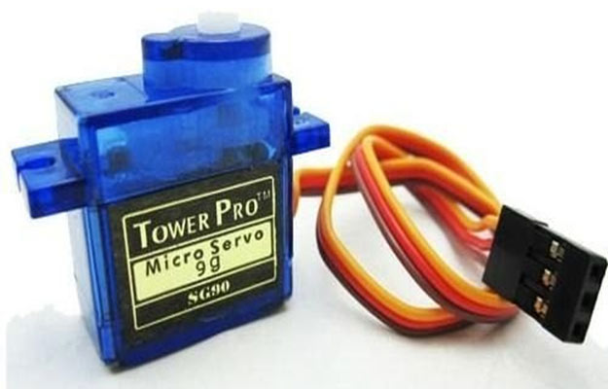
Servo Motor Description
Components:
Motor
Potentiometer: Shaft position
Gear Assembly: Reduce RPM to increase torque
Controlling circuit: Feedback
Input signal: PWM pulse width
An error signal is generated between the potentiometer and the input signal. The error signal causes the motor shaft to turn, changing the voltage on the potentiometer, thus reducing the error until the motor stops when the error is 0.

Slide 13
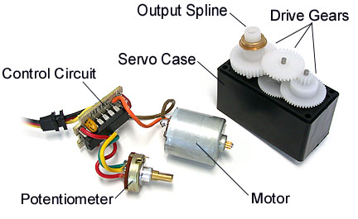
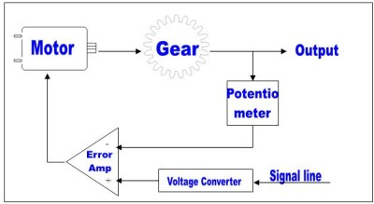
Servo Motor Description

Slide 14
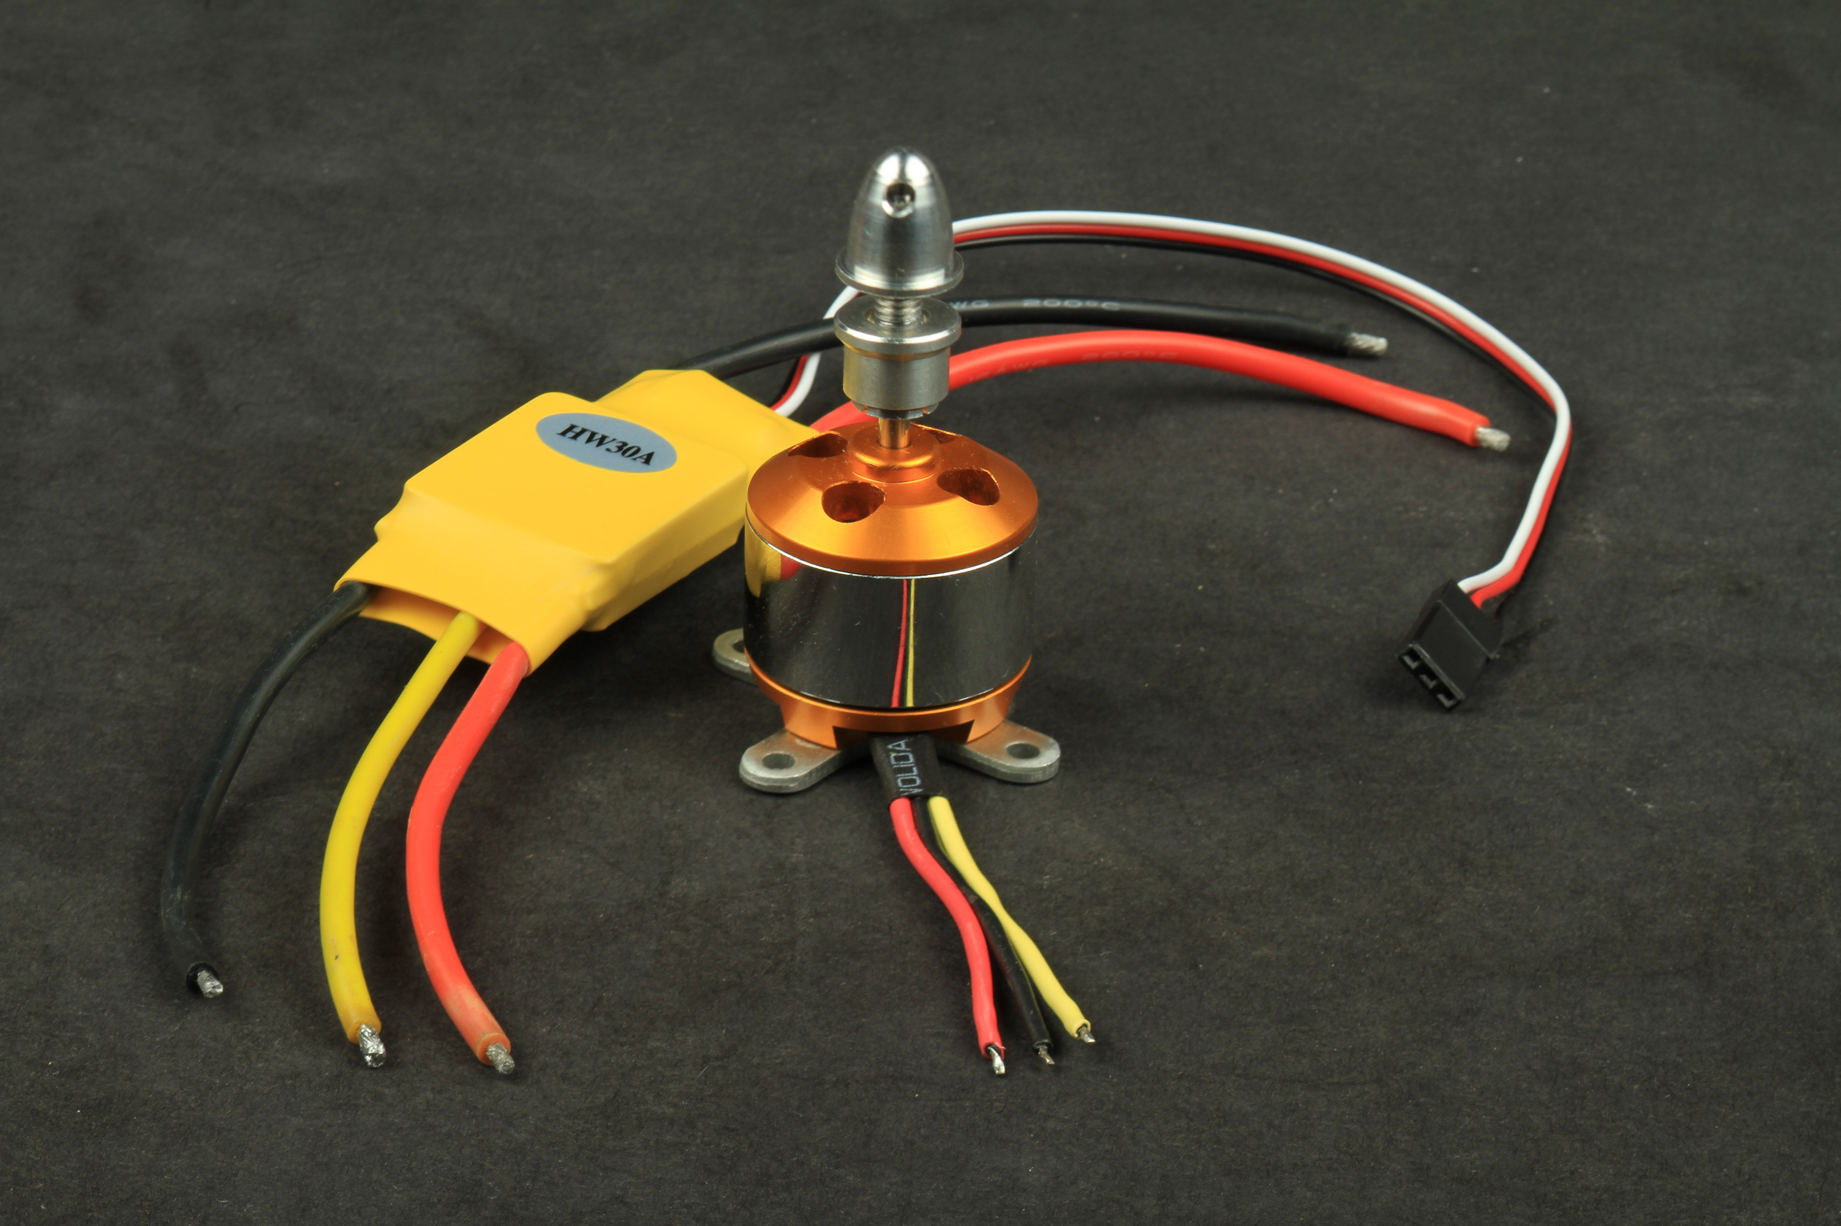
Brushless DC Motor (BLDC) Description
Brushless DC motor control is not quite as simple as the regular brushed type. Brushless motors require a controller that can sense the proper time to reverse the voltage to the coils.
Some motors have built-in hall-effect sensors that can detect the orientation of the rotor. Controllers for this type of motor require sensor inputs to read these hall sensors.
Other 'sensorless' motor controllers sense the back EMF in the motor coils themselves to detect the rotor position. Most ESC (Electronic Speed Controls) for brushless RC motors use this technique.
Brushless motors designed for autonomous and remote control aircraft and vehicles typically require a separate controller. These are typically of the sensorless type and use standard servo type pulsed signals for speed control.
Applications include RC controlled planes and drones.

Slide 15
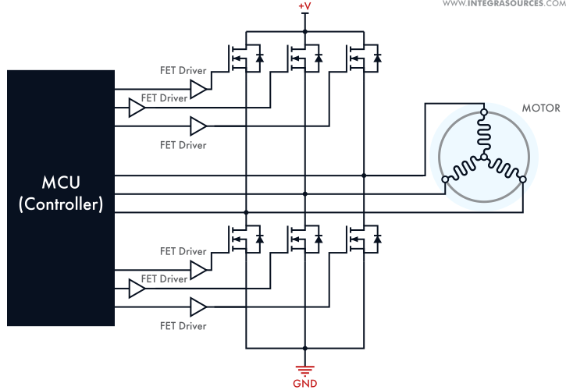
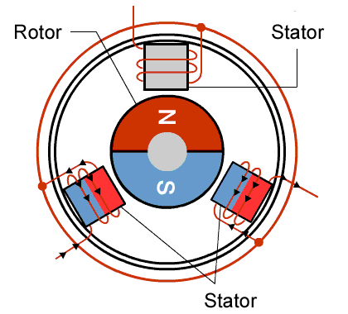
Brushless DC Motor (BLDC) Description

Slide 16
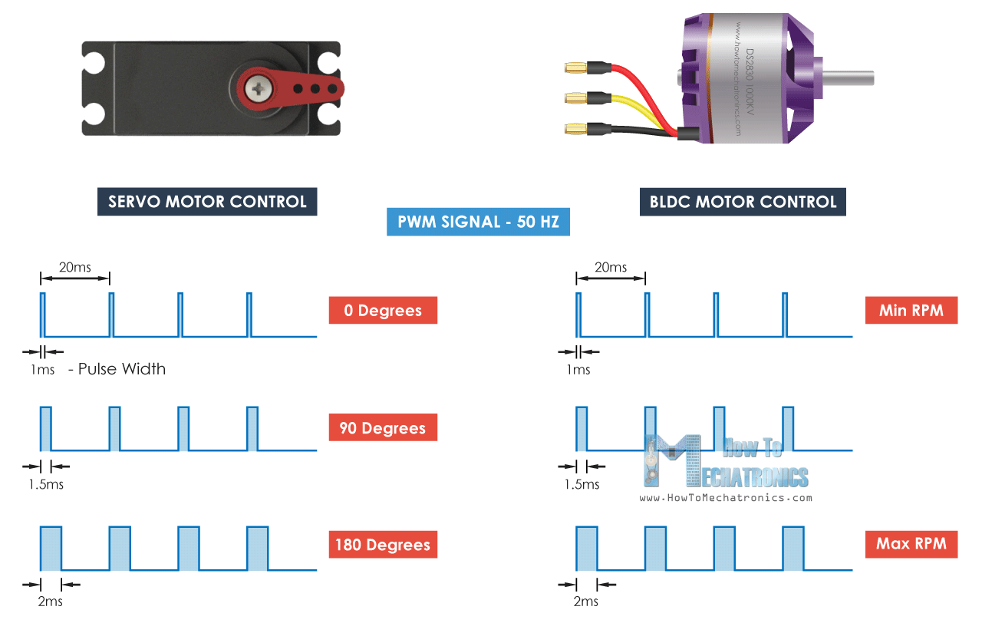
Servo/BLDC Control

Slide 17
Stepper Motor Description
Advantages
Steppers don’t require a sensor to detect the motor position since the motor moves by simply counting steps.
Although the motor does need a controller it doesn’t need complex calculation or tuning to work properly.
With micro stepping high positional accuracy can be achieved.
Good torque at low speed and great for holding position.
Disadvantages
Can miss steps if torque load is too high.
Always drain maximum current.
Low torque and noisy at high speeds.

Slide 18
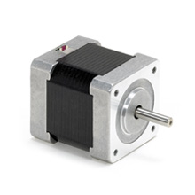
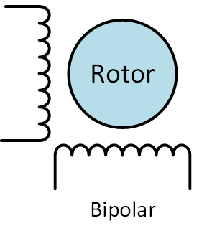
Bipolar Stepper Motor Example
TPP-47-002
NEMA 17
Step Angle: 1.8 degree (200 steps/rev)
Holding Torque: 33Ncm(47oz.in)
Rated Current/phase: 1.2 A
Phase Resistance: 2.4 ohms
Inductance: 4.7 mH
Application: 3D Printer
See the following Videos for illustrations of stepper operation:
https://www.youtube.com/watch?v=eyqwLiowZiU&list=WL&index=1
https://www.youtube.com/watch?v=VMwv4XFZ2L0&list=WL&index=5

Slide 19
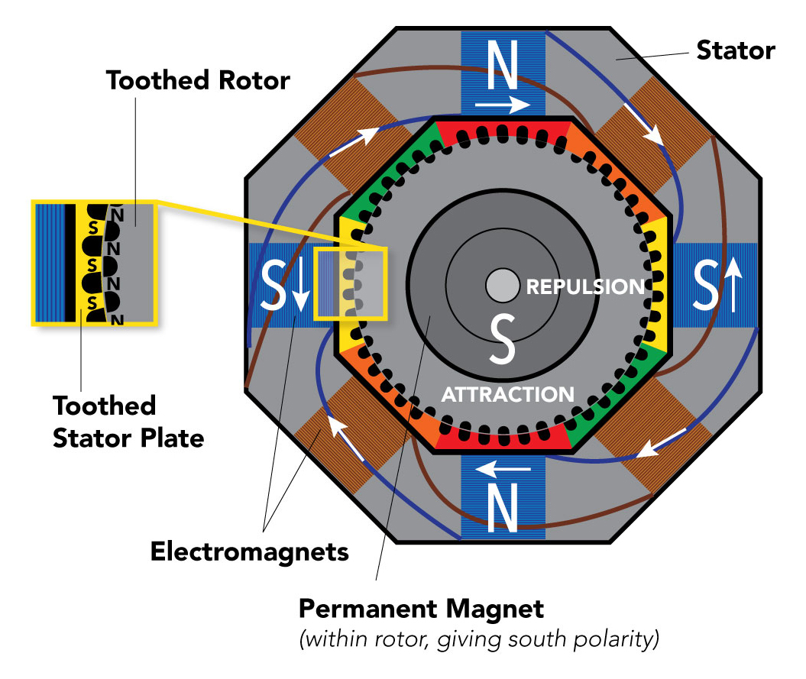
Stepper Motor Diagram
Source: https://clippard.com/cms/wiki/how-stepper-motors-provide-precision-control

Slide 20
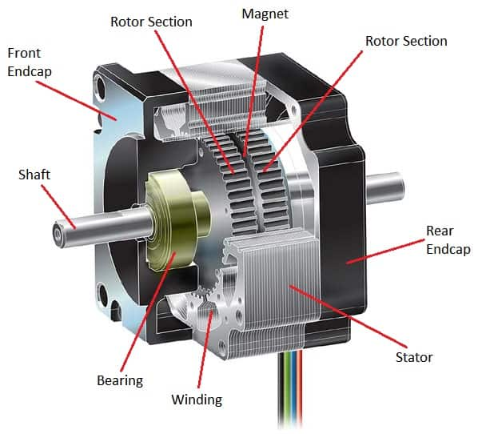
Stepper Motor Construction
Source: https://islproducts.com/design-note/stepper-motor-fundamentals/

Slide 21
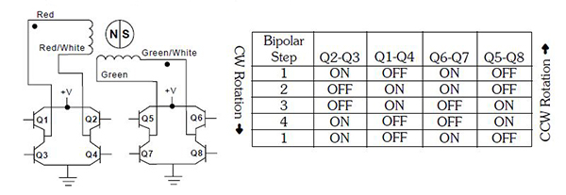
Bipolar Full Step Sequence

Slide 22
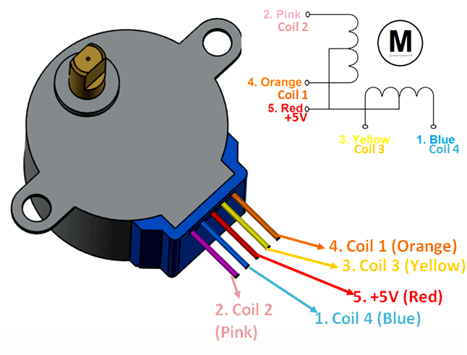
Unipolar Stepper Motor Example
28BYJ-48
5V Nominal Voltage
Number of Phases: 4
64:1 (63.68395:1) gearing
Full Step Sequence:
2048 (2038) steps per revolution
11.25°/64 (63.68395) Stride Angle
Half Step Sequence:
4096 (4076) steps per revolution
5.625°/64 (63.68395) Stride Angle
Pull in torque: 300 gf.cm
Insulated Power: 600VAC/1mA/1s
Coil: Unipolar 5 lead coil
More Info: https://lastminuteengineers.com/28byj48-stepper-motor-arduino-tutorial/#gear-reduction-ratio

Slide 23
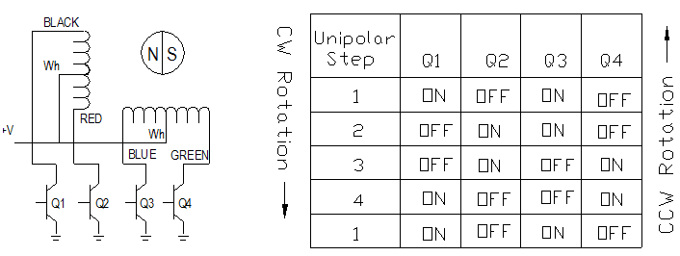
Unipolar Full Step Sequence

Slide 24
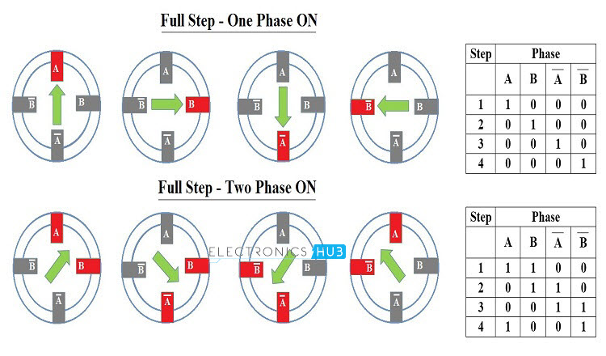
Stepper Motor – Full Step Sequence
Source: https://www.electronicshub.org/stepper-motor-control-using-arduino/

Slide 25
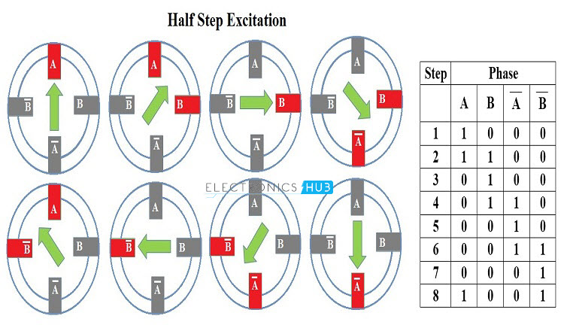
Stepper Motor – Half Step Sequence
Source: https://www.electronicshub.org/stepper-motor-control-using-arduino/

Slide 26
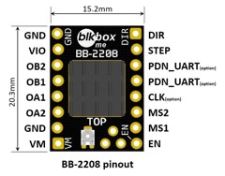
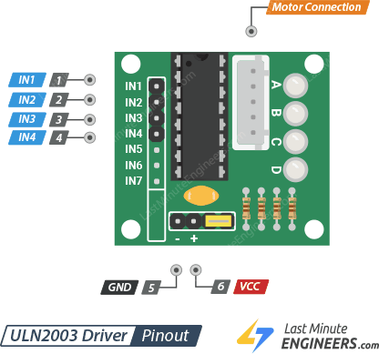
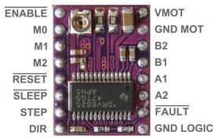
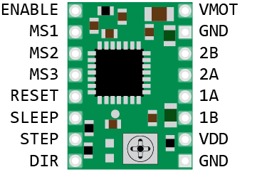
Stepper Motor Drivers
Model | DRV8825 | A4988 | TMC2208 | ULN2003
Type | Bipolar | Bipolar | Bipolar | Unipolar
Max Current per coil | 2.2 A | 2.0 A | 2.0 A | 600 mA
Continuous current per coil | 1.5 A | 1.0 A | 1.2 A
Max step resolution | 1/32 | 1/16 | 1/256 | N/A
Logic range | 2.5 – 5.25 V | 3 – 5.5 V | 3 – 5 V | 5 V
Supply Voltage Range | 8.2 – 45 V | 8 – 35 V | 5.5 – 36 V | 50 V
Interface | Step/Dir | Step/Dir | Step/Dir | Channels
Approximate cost | $9.00 | $2.00 | $15.00 | $1.50

Slide 27
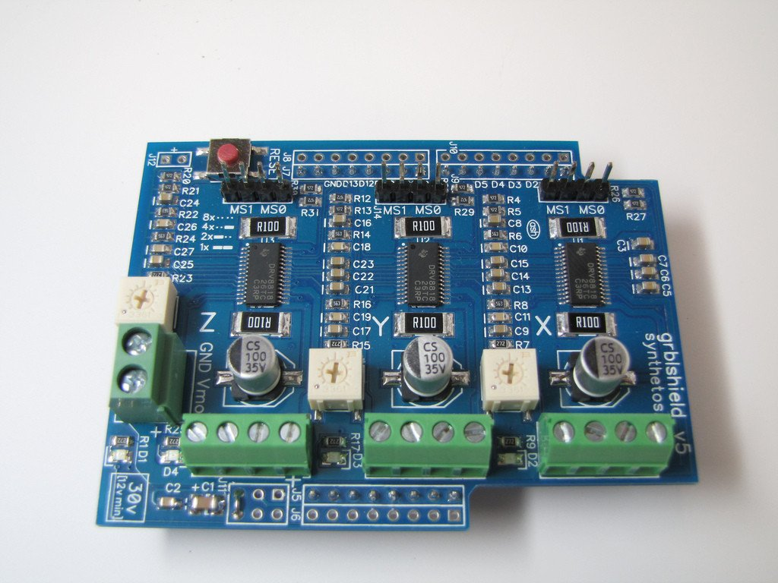
Integrated Stepper Motor Driver
gShield v5
~ $50
Arduino Uno Shield
3x TI DRV8818 Stepper Drivers
Runs grbl firmware
https://github.com/gnea/grbl
Application: CNC Router

Slide 28
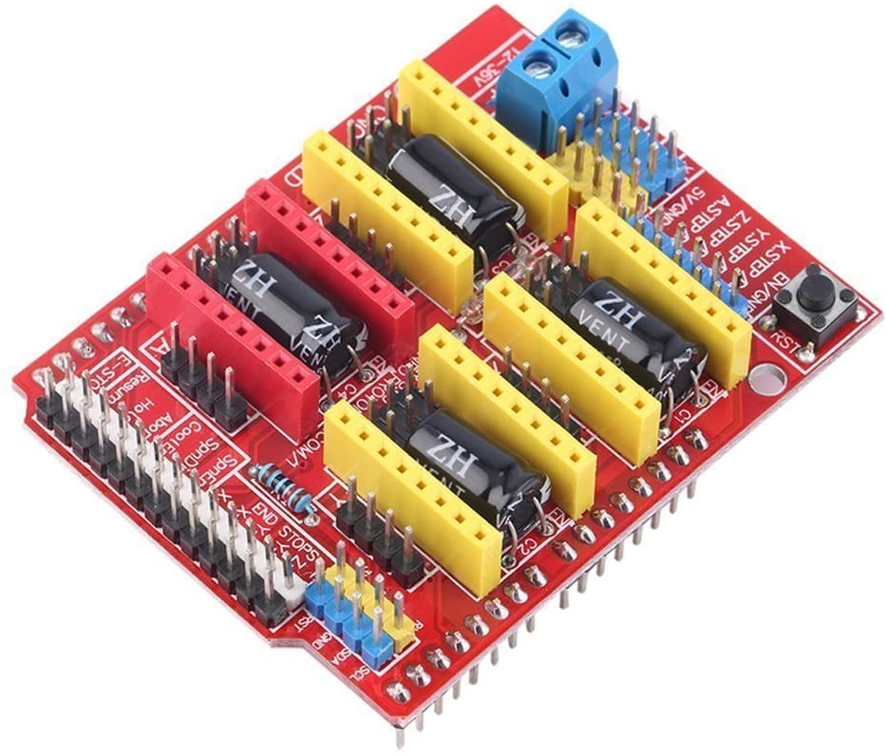
Integrated Stepper Motor Driver
RAMPS 1.4
~ $20 including DRV8825 Motor Drivers
Arduino Mega Shield
Different drivers may be used
Runs Marlin firmware
https://marlinfw.org/
Application: 3D printer

Slide 29
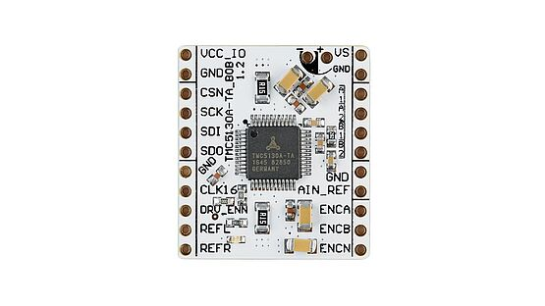
Motion Controller
Model | TMC5130A-TA
Type | MOSFET
Max Current per coil | 2.5A
Continuous current per coil | 2A
Max step resolution | 1/256
Logic range | Internal or 4.6 – 5.25 V external
Supply Voltage Range | 4.75 – 46V
Interface | SPI & Single Wire UART
Approximate cost | $20.00

Slide 30
Project IDE
Arduino IDE
Programming -> Arduino IDE
Arduino UNO or Arduino UNO clone
Tools -> Board -> Arduino UNO
Arduino Leonardo or Arduino Leonardo clone (Velleman - white board)
Tools -> Board -> Arduino Leonardo
Raspberry Pi IDE
Programming -> Geany (for Brushed DC and Servo Projects)
Programming -> Thonny (for Raspberry Pi Pico project)

Slide 31
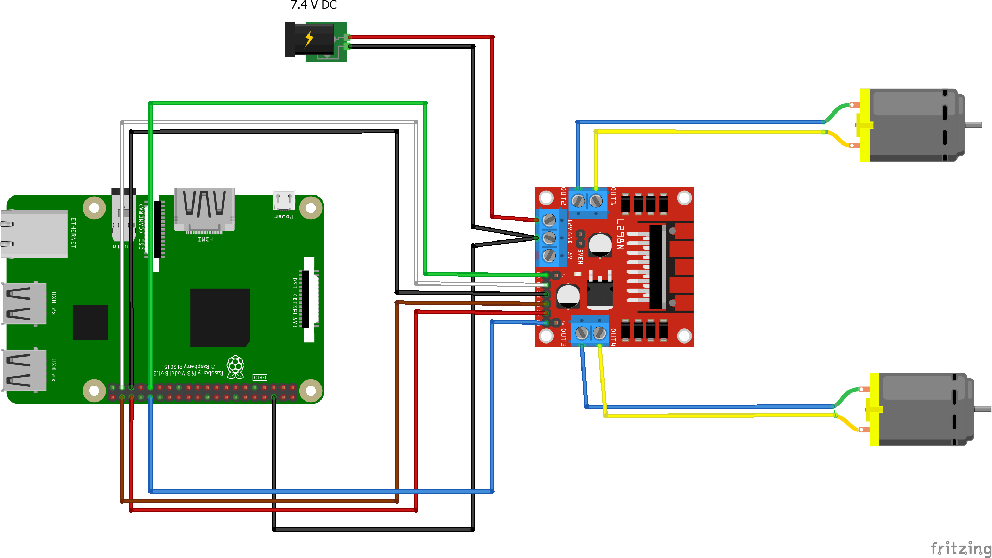
Project – Brushed DC Motor
Driver: L298N
Raspberry Pi Wiring
IN1 to GPIO26
IN2 to GPIO19
IN3 to GPIO20
IN4 to GPIO16
ENA to GPIO6
ENB to GPIO12
Set power supply output to 7.4 V.
Open MotionControlClass/BrushedDC/key_brushedDc.py using the Geany IDE.
Run key_brushedDc.py.
Put cursor focus in terminal window that pops up.
Arrow keys to move motors.
‘s’ key to slow the motor, ‘f’ key to speed up the motor.
Enter key to stop.
‘q’ or ctrl-c to terminate program.
Consider how to control the speed of the motors.

Slide 32
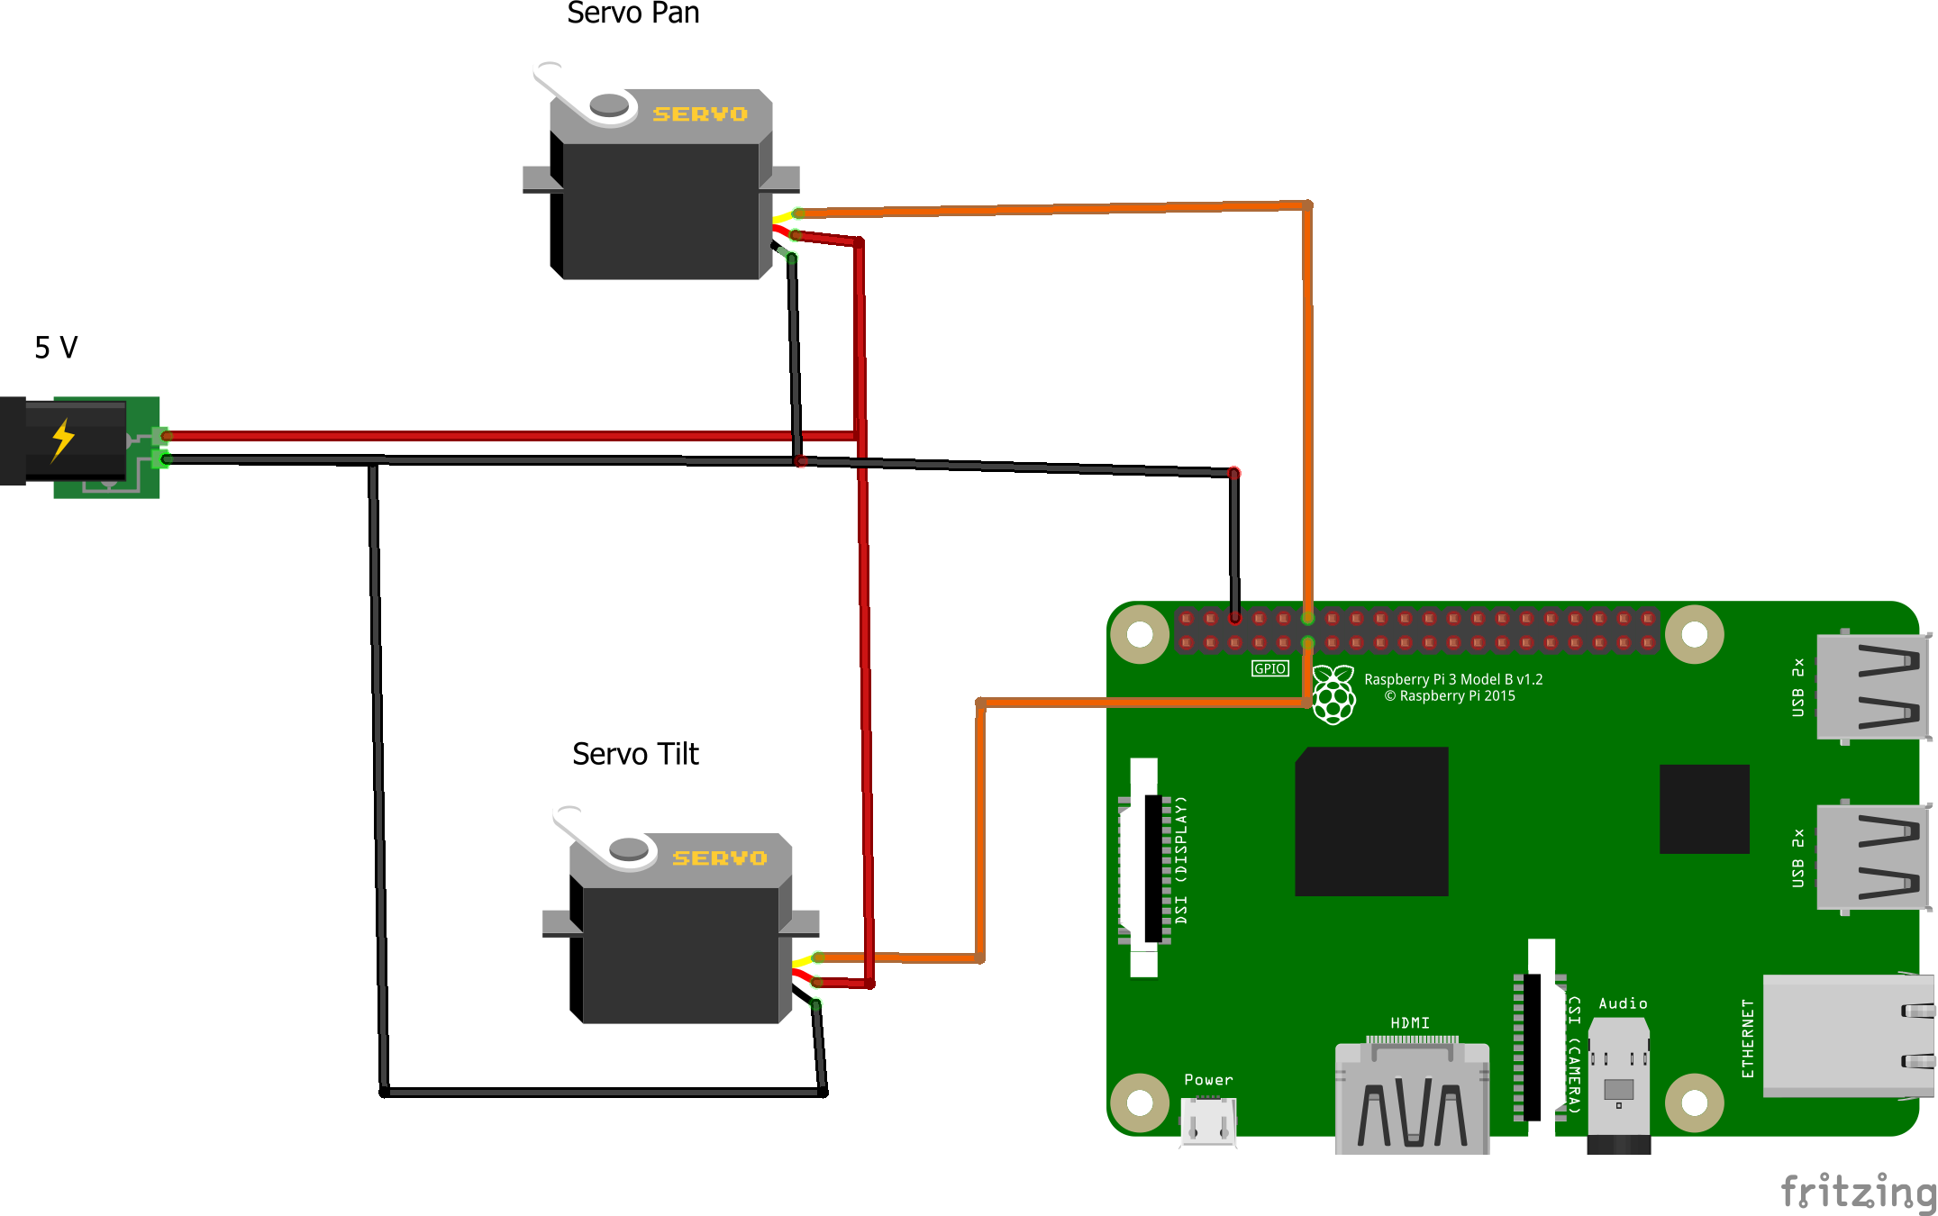
Project – Servo Motor
Use mechanical crane
Raspberry Pi Wiring:
Servo Pan: GPIO18
Servo Tilt: GPIO17
Set power supply output to 5V
Open MotionControlClass/ServoMotor/key_ServoMotor.py using the Geany IDE
Run key_ServoMotor.py
Put cursor focus in terminal window that pops up.
Arrow keys to move motors.
Enter key to stop
‘q’ to terminate program

Slide 33
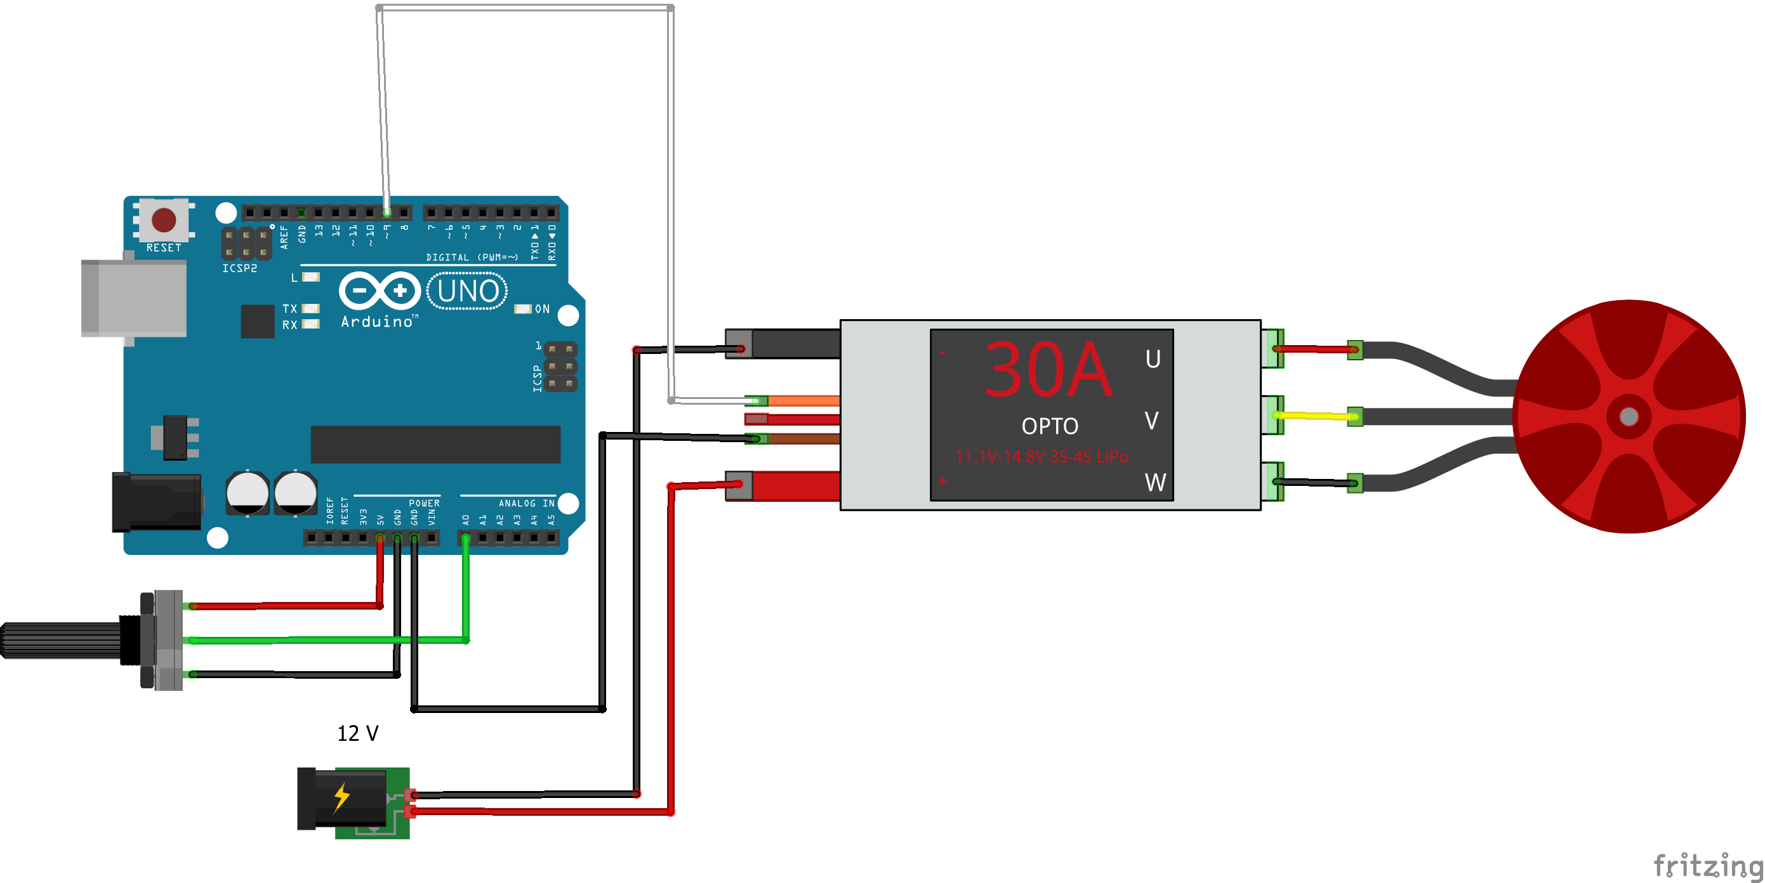
Project – Brushless DC Motor
Driver: ESC
Guide: https://howtomechatronics.com/tutorials/arduino/arduino-brushless-motor-control-tutorial-esc-bldc/
Arduino Wiring:
Speed control: Pin 9 (White)
Pot Wiper: A0 (Green)
Set power supply output to 12V but do not enable the power supply
Open MotionControlClass/BldcMotor/BldcMotor.ino using the Arduino IDE
Upload the sketch
Turn pot full clockwise
Enable the power supply
The motor speed is controlled with the pot. If the pot is full on (counter clockwise) on then the motor will not start and must be calibrated (see Guide).

Slide 34
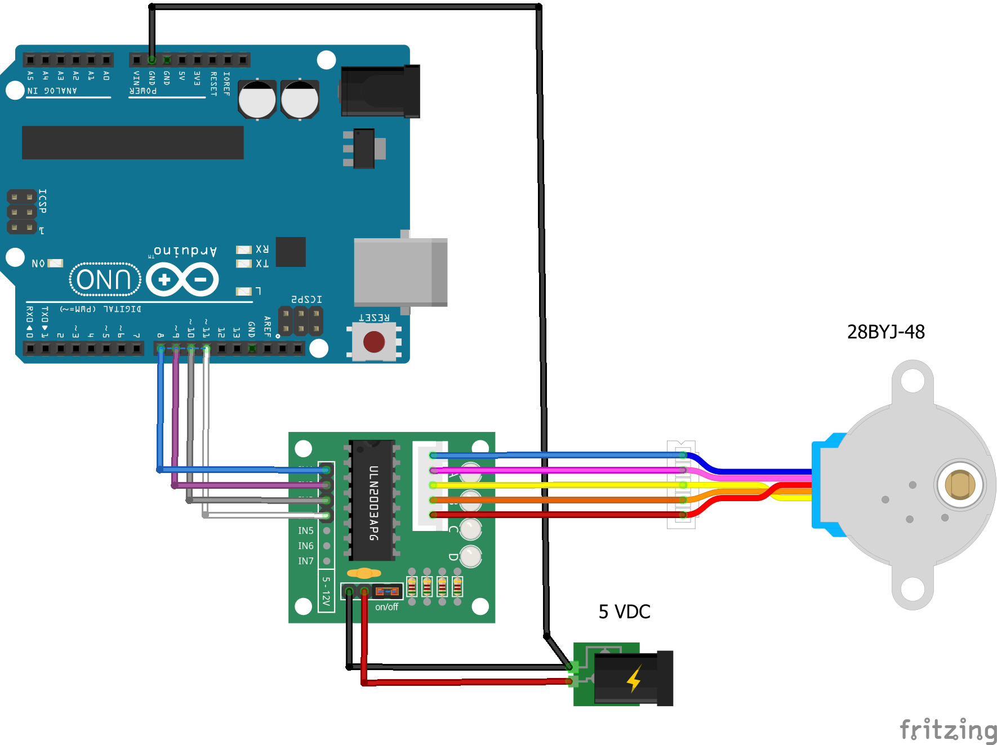
Project – Unipolar Stepper Motor
Driver: ULN2003
Guide: https://www.makerguides.com/28byj-48-stepper-motor-arduino-tutorial/
Arduino Wiring
IN1 to Pin 11
IN2 to Pin 10
IN3 to Pin 9
IN4 to Pin 8
Set power supply output to 5V
Open MotionControlClass/UnipolarStepper/BasicUnipolarStepper/BasicUnipolarStepper.ino using the Arduino IDE
Upload the sketch
The motor will rotate 1 revolution, reverse and rotate 1 revolution in the opposite direction and repeat forever.
Try changing the motor speed and/or the number of revolutions
Observe in the Serial Monitor when the motor changes direction

Slide 35
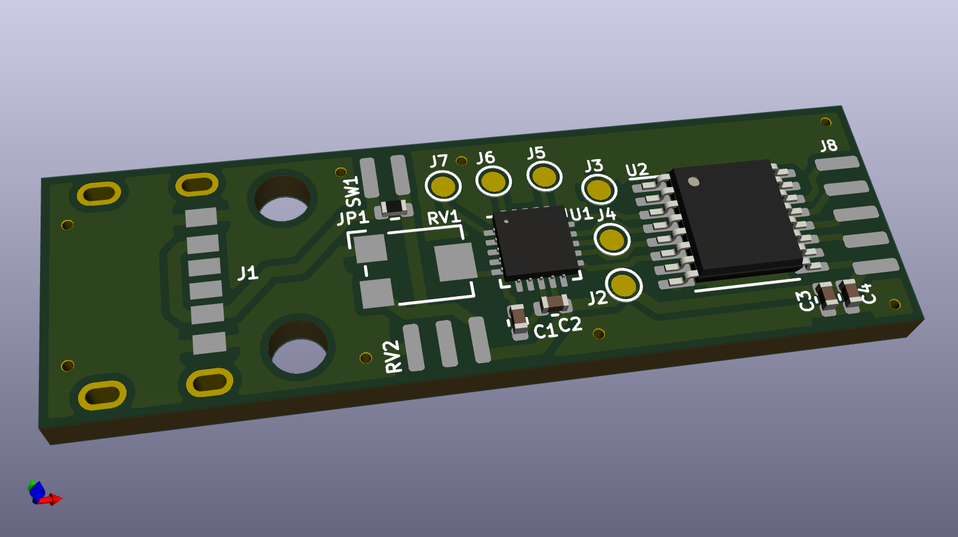
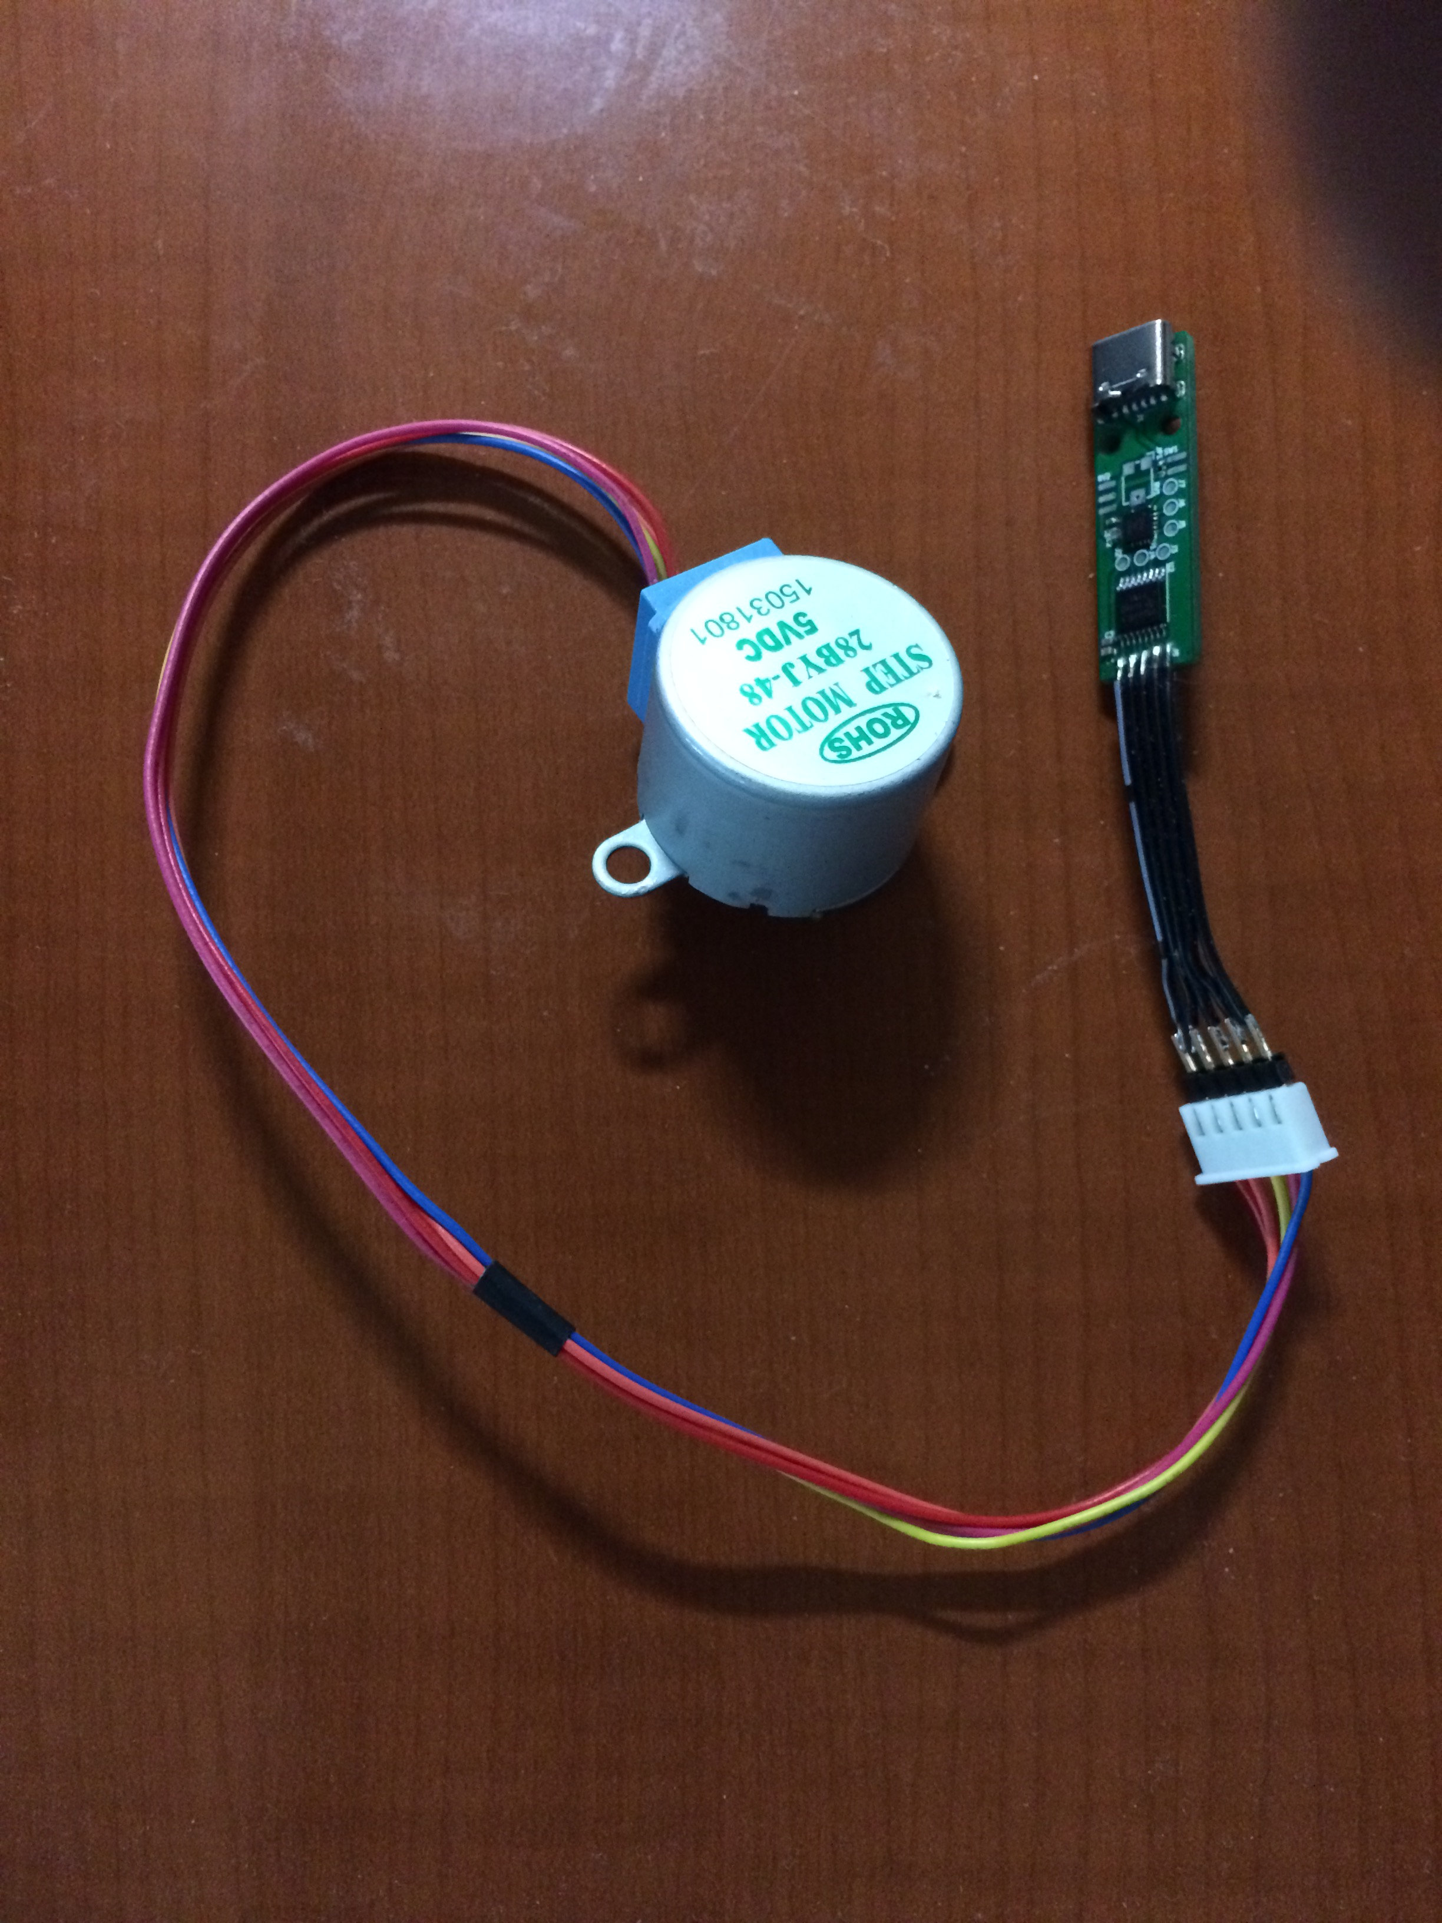
Project: Unipolar with ATTiny
Driver: ULN2003
Plug in 28BYJ-48 motor with red wire nearest C3/C4
Power board with USB-C power block
The motor will rotate in the clockwise direction looking at the shaft side of the motor.

Slide 36
Project: Unipolar with ATTiny
This ATTiny code snippet demonstrates how to half-step sequence the ULN2003 driver. This function is called in a forever loop that includes a delay:
// ------ Event loop ------ //
while (1) {
_delay_us( StepDelay_us ); decrMotor();
}
static inline void decrMotor( void ){
switch( MotorState ){ //prior to decrement
case 7: //1001->X___->0001
clear_bit( S1_PORT, S1 );
break;
case 6: //0001->__^_->0011
set_bit( S3_PORT, S3 );
break;
case 5: //0011->___X->0010
clear_bit( S4_PORT, S4 );
break;
case 4: //0010->_^__->0110
set_bit( S2_PORT, S2 );
break;
case 3: //0110->__X_->0100
clear_bit( S3_PORT, S3 );
break;
case 2: //0100->^___->1100
set_bit( S1_PORT, S1 );
break;
case 1: //1100->_X__->1000
clear_bit( S2_PORT, S2 );
break;
case 0: //1000->___^->1001
set_bit( S4_PORT, S4 );
MotorState = 8;
break;
} MotorState--;
}

Slide 37
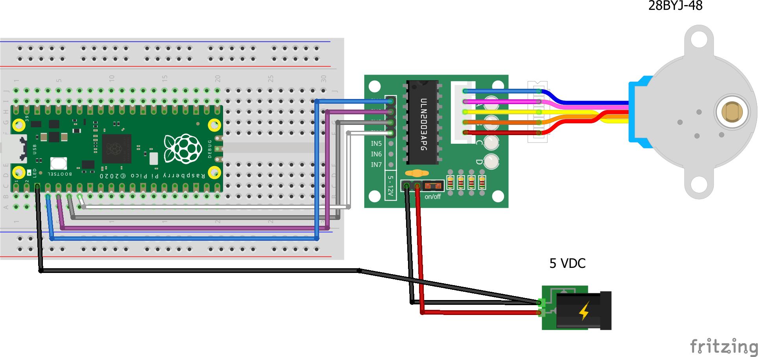
Project – Unipolar Stepper w/Pi Pico
Driver: ULN2003
Pi Pico Wiring
IN1 to GP2
IN2 to GP3
IN3 to GP4
IN4 to GP5
Power supply GND to GND on Pico
Connect Pi Pico to Raspberry Pi Model B via USB
Start the Thonny IDE and select MicroPython (Raspberry Pi Pico) in the bottom left corner.
Load stepper.py from the Pi Pico
Connect 5 V power
Execute the program stepper.py
The motor will rotate 1 revolution CW, reverse and rotate 1 revolution CCW and repeat for 50 seconds.
Try changing the program to half step mode and observe what happens.

Slide 38
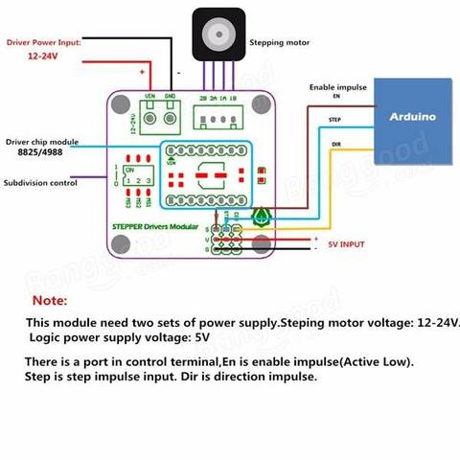
Project – Bipolar Stepper Motor
Driver: DRV8825 or A4988
Guide: https://www.makerguides.com/drv8825-stepper-motor-driver-arduino-tutorial/
Arduino Wiring (from 9 pin block labeled S-V-G / EN-STEP-DIR):
EN (Enable impulse): jumper to GND (done: black wire)
DIR: Arduino Pin 2 (orange wire)
STEP: Arduino Pin 3 (yellow wire)
5V INPUT: Arduino 5V and GND (red-V and brown-G wires)
Set power supply output to 12V but do not enable the power supply
If necessary, adjust current limit according to Guide: V_{ref} = I_{max} / 2 for DRV8825 or V_{ref} = I_{max} * 8 * R_{s} for A4988 (R_{s} = 0.1 ohm for demo driver)
Open MotionControlClass/BipolarStepper/BasicBipolarStepper/BasicBipolarStepper.ino using the Arduino IDE
Upload the sketch
Enable the power supply output
The motor will move slowly one revolution (full step mode), a little faster in reverse direction and then quite fast in both directions for 5 revolutions and then repeat.
Try changing subdivision control: Disable power supply, change DIP switch, Enable power supply. Consider how to improve the program by using variables to control the speed and number of revolutions.

Slide 39
Project – Bipolar Stepper Motor
Acceleration library example
Driver: DRV8825 or A4988
Guide: https://www.makerguides.com/drv8825-stepper-motor-driver-arduino-tutorial/
Arduino Wiring (from 9 pin block labeled S-V-G / EN-STEP-DIR):
EN (Enable impulse): jumper to GND (done: black wire)
DIIR: Arduino Pin 3 (orange wire)
STEP: Arduino Pin 2 (yellow wire)
5V INPUT: Arduino 5V and GND (red-V and brown-G wires)
Set power supply output to 12V but do not enable the power supply
If necessary, adjust current limit according to Guide: V_{ref} = I_{max} / 2 for DRV8825 or V_{ref} = I_{max} * 8 * R_{s} for A4988 (R_{s} = 0.1 ohm for demo driver)
Open MotionControlClass/BipolarStepper/BasicBipolarStepper/AccelBipolarStepper.ino using the Arduino IDE
Upload the sketch
Enable the power supply output
The motor will rotate 600 steps (3 revolutions in full step mode) but accelerate up to speed and decelerate when stopping.
Try changing the number of total steps, max speed and acceleration: Disable power supply, make change and upload new sketch and enable power supply.

